Slide 1
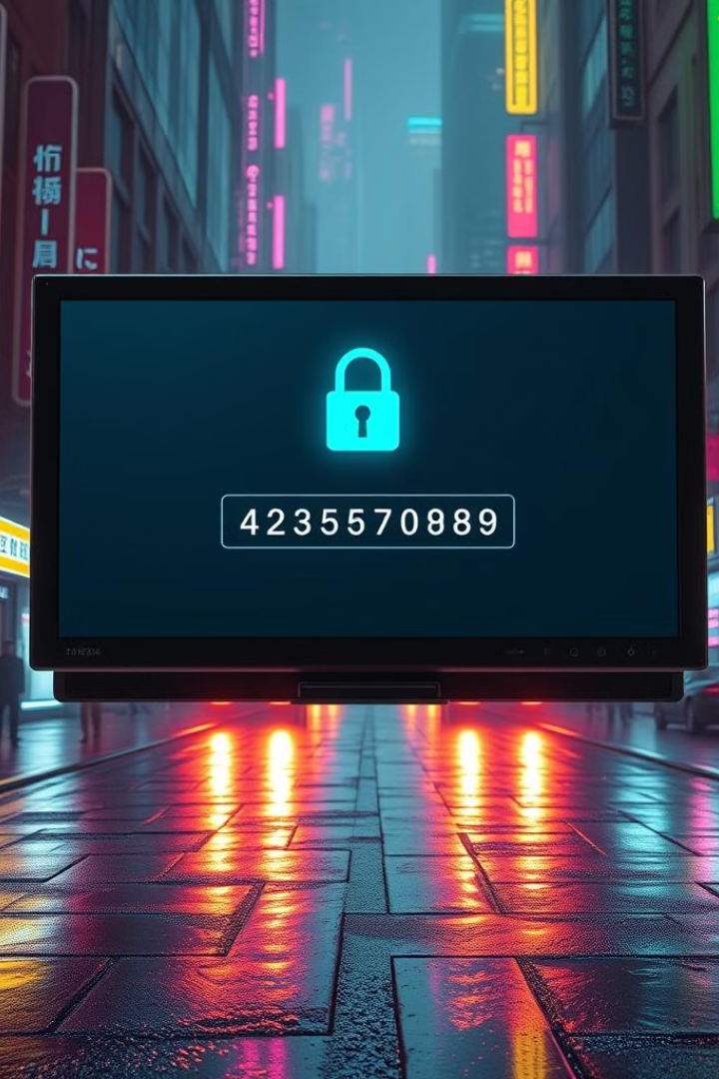

Password Validator
M.Sudharsanan
Submission Date:15/10/2024

Slide 2
Project Objective
1
Strong Passwords
Enforce strong and secure passwords
2
User Feedback
Provide clear feedback on password strength
3
Enhanced Security
Enforce password rules and security standards

Slide 3
Problem Statement
Weak Passwords
Easy to Guess
Security Risks
Common vulnerability for digital security breaches
Users often create simple passwords
Need a robust system to improve security

Slide 4
Project Overview
Python-based Validator
Uses regular expressions for password strength checks
Key Features
Length validation, character type checks, and feedback

Slide 5
Main Functionalities
1
Length Check
Minimum length requirement of 8 characters
2
Uppercase & Lowercase Letters
Verifies presence of both upper and lower case letters
3
Digit Requirement
At least one number required in the password
4
Special Character Check
Ensures inclusion of at least one special character

Slide 6



Additional Functionalities
Strength Rating
Rates passwords as Weak, Medium, or Strong
Detailed Feedback
Provides specific error messages if the password fails criteria
Secure Input
Uses getpass to hide password input

Slide 7



Input Handling & Error Handling
Password Input
Criteria Checks
Clear Feedback
Accepts various password types
Checks passwords against multiple criteria
Provides specific error messages and suggestions

Slide 8
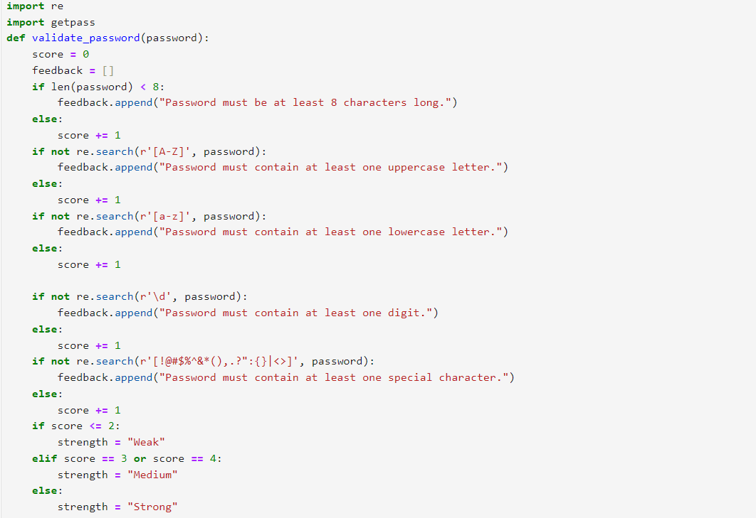
Code Implementation

Slide 9
Project Results & Outcome
1
Password Enforcement
Enforces password rules, improving password strength
2
User Feedback
Provides valuable feedback to improve password quality
3
Enhanced Security
Contributes to improved password security for users

Slide 10
Key Points & Future Improvements
Key Points
Future Improvements
Improves password strength and security
Implement password history checks and blacklist common passwords
Provides clear and user-friendly feedback

